Slide 1
Elizabeth Howard: Program Manager John Tapia: Faculty Fellow
Engineering Learning Communities

Slide 2
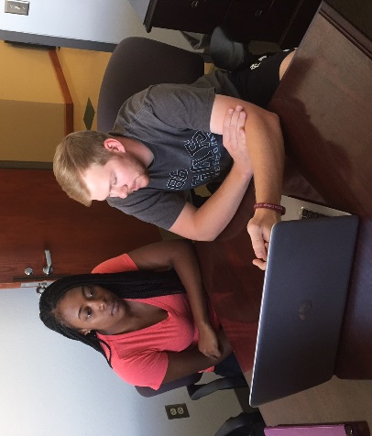
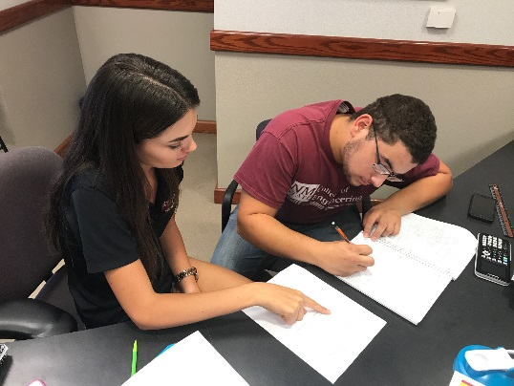
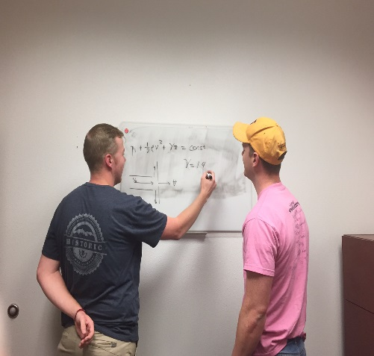
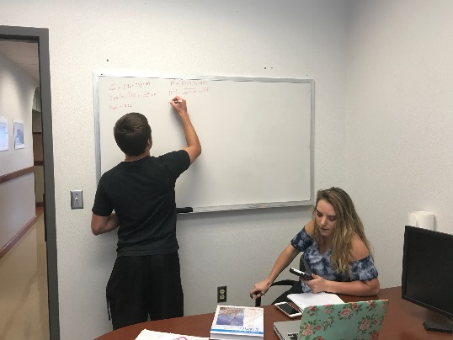
Vision
Learning Communities will give NMSU engineering students the opportunity to develop the skills they need to succeed in school, at work and in life.

Slide 3
Learning Communities Staff
Peer Learning Facilitators (peer mentors/tutors):
Attend ENGR 100 class
Teach weekly workshop to students (academic and life skills)
Host office hours in Learning Communities to serve as mentors and tutors for all engineering students
Faculty Mentoring:
Faculty mentors will be available for all students and especially “at risk” students

Slide 4
Services
Industry Speakers
Host info sessions
Mock Interviews
Resume building
Workshops:
Career Services workshops (resume, interview techniques, etc.)
GRE Preparation workshop (Student Success Center)
Writing Center hours in Learning Community

Slide 5
Reoccurring Services
Peer mentoring and tutoring
Review study sessions for ENGR 100, Math 190/191/192, CHEM 111, PHYS 215
Faculty mentoring
Quick Connect: Intervention procedure for “at risk” students

Slide 6
Interventions
QuickConnect: Faculty reporting system for “at risk” students
Repeat coursework for all Engineering, Math, and Science courses- procedure to get students back on track
6-week performance grade- all students with at least 1 C or below will be encouraged to attend tutoring
Students enrolled in ENGR 100 will be required to attend

Slide 7
Tentative Assessment Plan
Survey Monkey (pre and post tutoring/mentor service)
Tracking relationships between mid and final grade for students who receive tutoring
Persistence of students who attend activities/services in the LC
Identify certain demographics and their progress (Example: women, minority, first generation)

Slide 8
Who have we served in 20 Days… Over 250 Students!

Slide 9
Interesting Trends
1/3 of the students return for additional services
Group study sessions attract large groups of students
Individual study sessions are extremely beneficial for students who are embarrassed about receiving help
We need additional peer mentors and tutors to cover the demand of the space.

Slide 10
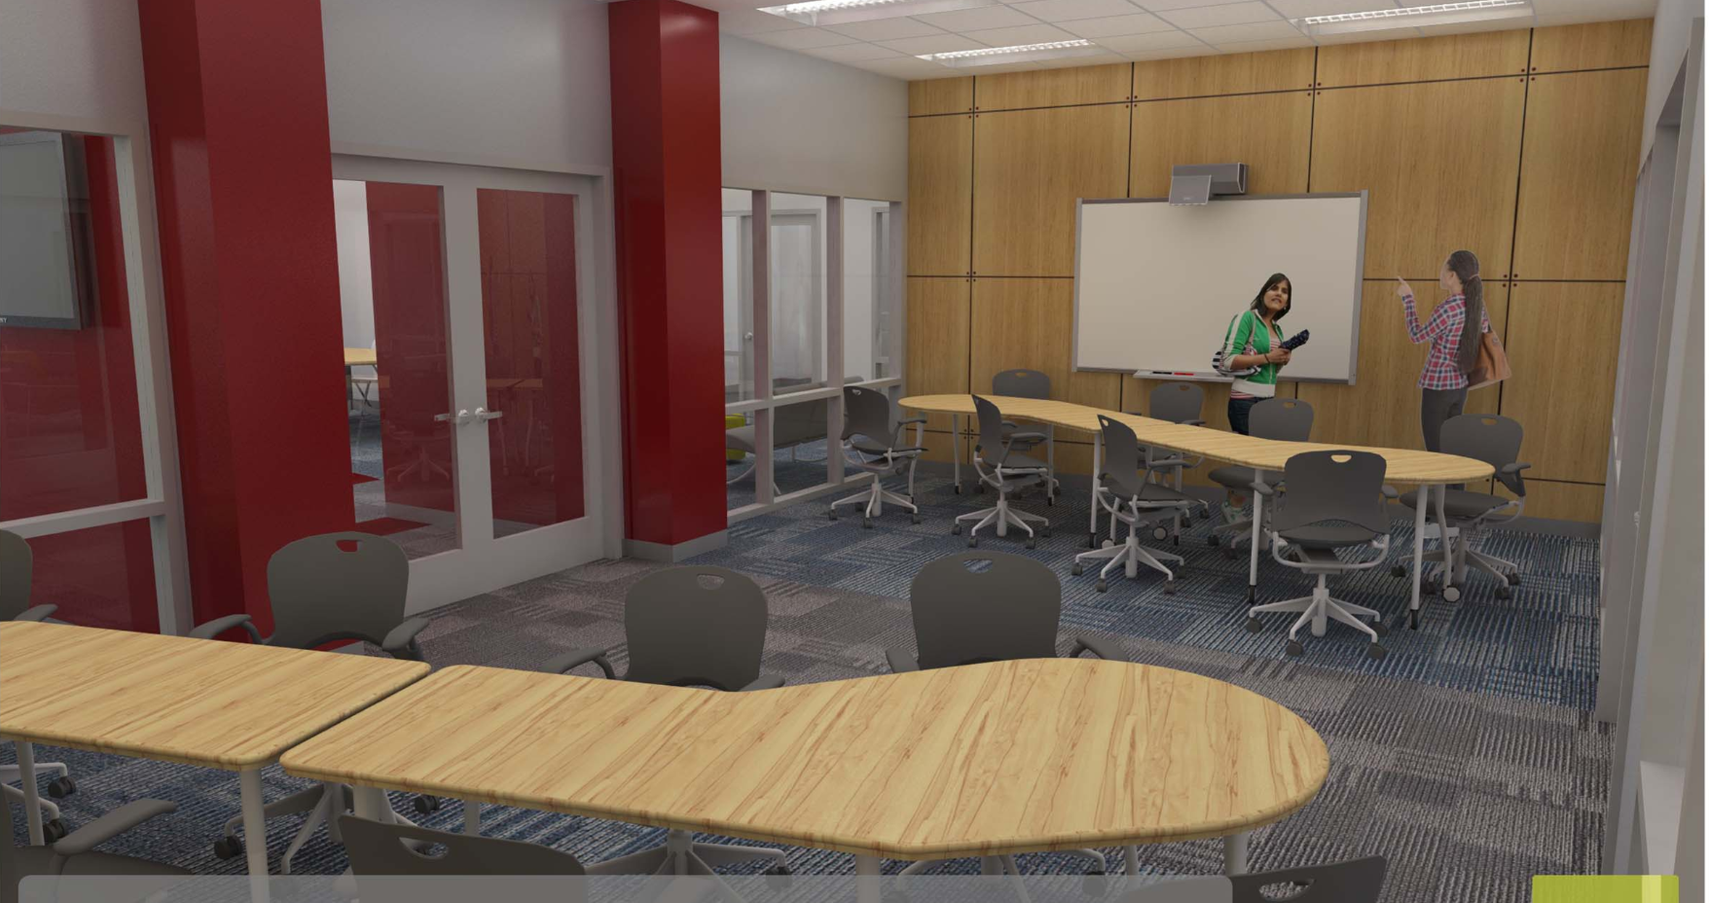
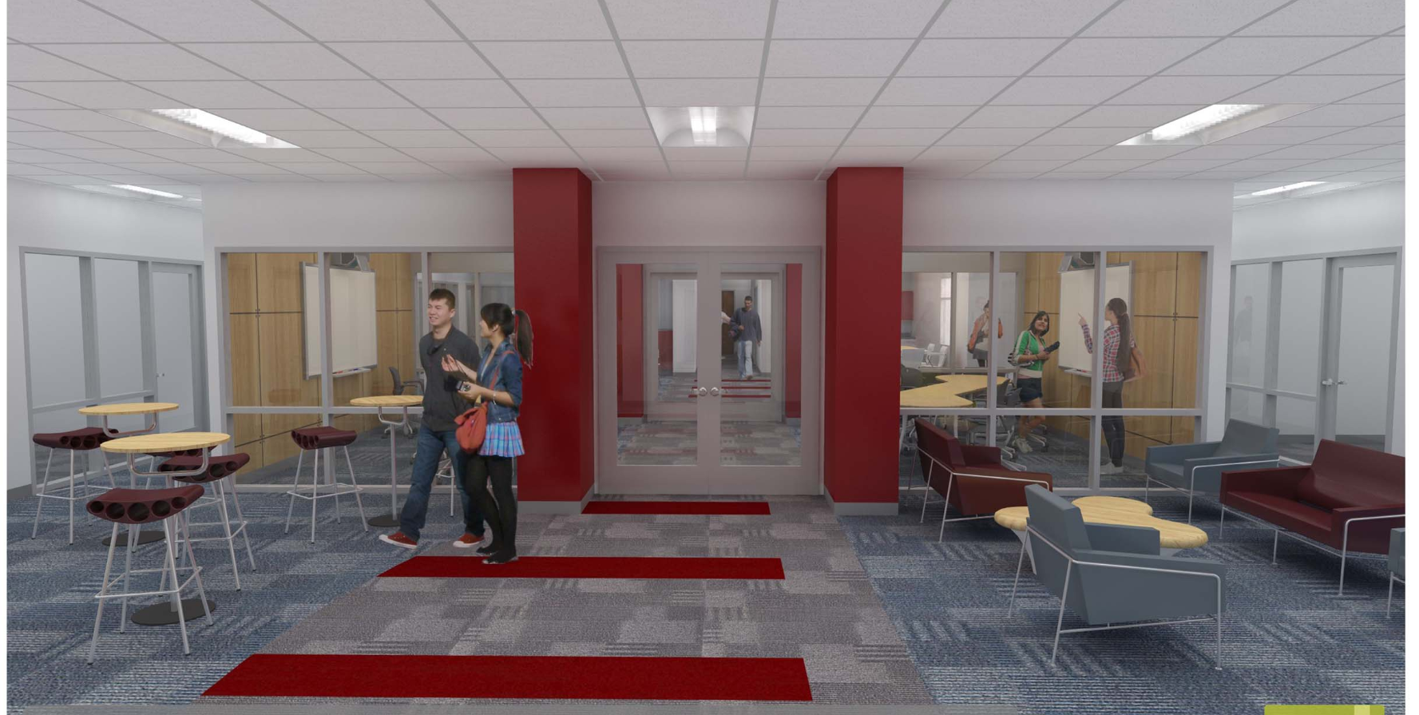
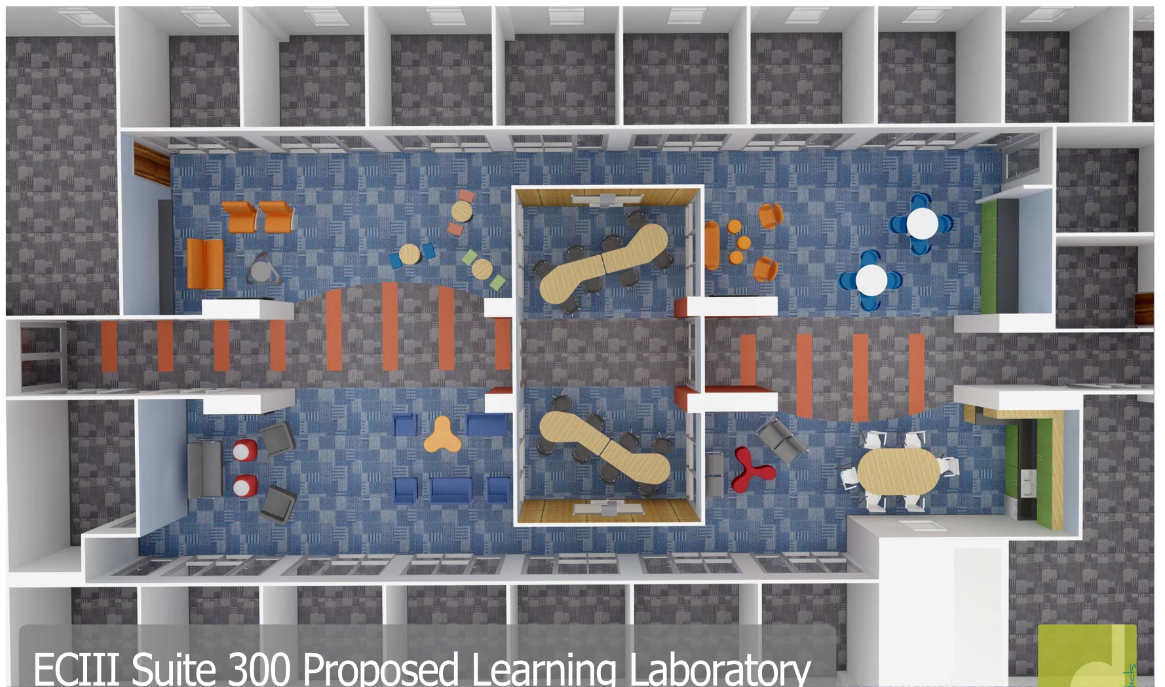
What’s Next & Questions…

